Slide 1

Supervisory Control of a Warehouse Robot System FINAL ASSIGNMENT 2019-2020 (2PDASDSCS)
December 16, 2019
A. Kalra, PDEng. Trainee MSD
P. Biswas, PDEng. Trainee MSD
T.S.R. Parvathaneni, PDEng. Trainee ASD
Department of Mathematics and Computer Science Engineering, Automotive Systems Design

Slide 2
OVERVIEW
INTRODUCTION (Amazon warehouse system)
ASSUMPTIONS
REQUIREMENTS
PLANT DEFINITIONS
DEMO
SYSTEM OF MULTIPLE ROBOTS
CONCLUSION

Slide 3
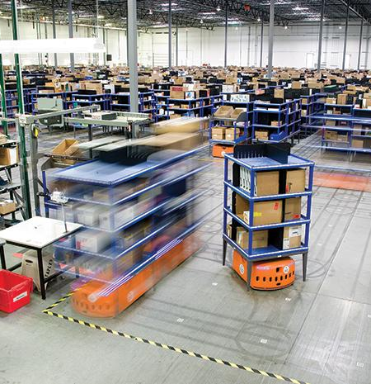
INTRODUCTION - Amazon Robotics System
Numerous autonomous agents moving along a grid in warehouse - Centralised server.
Wifi network communicates with robots equipped with numerous sensors and two brushless DC motors.
Barcode stickers on the floor and camera - sensing robot location.
Infrared and proximity sensors - observe nearby area around itself - prevent collision with other robots or humans.

Slide 4
INTRODUCTION - Amazon Robotics System Levels of abstraction
Low-level controller | Feedback loops - drive the vehicle with high precision
Supervisory Controller | Safety requirements (e.g. collision avoidance) ; Execution order of different tasks (e.g. pick, place, rotation)
Path Planning Controller | Path planning from the current to the desired destination
Resource Allocation Controller | Dynamic resource allocation
A centralised supervisor architecture is designed to coordinate all vehicles in the system to ensure safe behavior and interface with the other subsystems i.e., Path planning controller, low-level controllers, camera sensors, proximity, touch sensitive and IR sensors.

Slide 5
INTRODUCTION
Assumptions Made
Human intervenes when the vehicle stops upon obstacle detection or touch sensitive trigger after a set time period and the vehicle does not get stuck in the loop indefinitely.
The vehicle receives destination location only at the initial warehouse location.
The initial warehouse location of all robots is the same as charging stations, i.e., the robots get available to begin a job at the charging station.
The communication systems, sensors, actuators and other interfacing systems are completely functional and are assumed to not fail in the middle of a job.
The AGV aligns perfectly with the product stack, eliminating the need of a product barcode camera.
Camera, IR proximity and touch sensitive sensors are powered and functional the entire time.
The vehicle always moves straight and any other movement (for example: turning right or left or backwards) is communicated to the robot by the path planner.
The vehicle is equipped with level sensors to indicate the levels and intermediate stage of the lever.

Slide 6
Requirement definition process
WBS | Requirement | Type | Derived Requirement
SPECIAL ACTIONS
M1 | Specials actions must only be implemented at the location bar codes | Functional | D1, D9, D10, D13
M2 | Raising or lowering of the rack disables vehicle movement | Functional | D1, D3
M4 | Raising or lowering occur only when obstacle sensor is not triggered | Functional | D1, M3, D11
D3 | Intermediate stage of the rack level turns off vehicle movement | Behavioral
D1 | Vehicle movement is set to idle during special actions. | Behavioral
D11 | Vehicle rotation when the rack is in intermediate stage | Behavioral
OBSTACLE AND TOUCH SENSORS
M3 | The vehicle must avoid all collisions | Functional | D2
M4 | IR proximity sensor disables vehicle movement | Functional | D2
M5 | Vehicle movement is immediately disabled when touch sensitive sensor is triggered | Behavioral | D2
D2 | Touch sensitive and IR proximity sensors are always active. | Technical

Slide 7
Requirement definition process
WBS | Requirement | Type | Derived Requirement
BATTERY CHARGING REQUIREMENTS
M6 | Human assistance is required for critically low battery. | Functional | D8
M7 | Vehicle starts after charging only when battery level is full | Functional | D7
D4 | Critical or low battery levels trigger fetching location | Behavioral
D5 | Vehicle moves only when path planner has been executed | Behavioral | D9
D6 | Charging is enabled only when vehicle reaches charging station | Behavioral | D5
D7 | Low or critical battery levels at charging station disable vehicle movement | Behavioral | D6
D8 | Critical battery stops vehicle movement and notifies of position on the grid | Behavioral
D12 | Critical and low battery levels must disable special actions | Behavioral
CAMERA SENSOR REQUIREMENTS
D9 | Camera sensor is always powered | Technical
D13 | Barcode scanning must disable vehicle movement | Behavioral
D10 | Detected barcode enables the options to perform special movements | Behavioral

Slide 8
PLANT DEFINITIONS
Start
Vehicle Movement
Controllable events - Start and Stop
States - Idle and Move
Initial and Marked state - Idle
IDLE
MOVE
Stop

Slide 9
PLANT DEFINITIONS - Special Actions
Auxiliary Movements
Vehicle Lever Movements
Controllable events - Rotate and Stop Rotate
States - Rotation and No Rotation
Initial and Marked state - Rotation
Controllable events - Raise and Lower
Uncontrollable event - Intermediate
States - Low, High, Low to High, High to Low
Initial and Marked state - Idle
Rotate
Raise
LOW 2 HIGH
Intermediate
NO ROTATION
ROTATION
LOW
HIGH
Intermediate
Lower
HIGH 2 LOW
Stop Rotate

Slide 10
PLANT DEFINITIONS - Sensors
IR Proximity sensor
Touch sensitive sensor
Uncontrollable events - Turning on and Turning off
States - On and Off
Initial and Marked state - Off
Uncontrollable events - Turning on and Turning off
States - On and Off
Initial and Marked state - Off
Turning On
Turning On
OFF
ON
OFF
ON
Turning Off
Turning Off

Slide 11
PLANT DEFINITIONS
Get
Destination
Vehicle Status
Is Available
Controllable events - Is Available, In Process, Execute Path Planner, Get Destination and Job Completed
States - Idle, Available, Fetching destination, In execution and Busy
Initial and Marked state - Idle
IDLE
AVAILABLE
FETCHING DESTINATION
Execute Path Planner
Job Completed
BUSY
IN EXECUTION
In Process

Slide 12
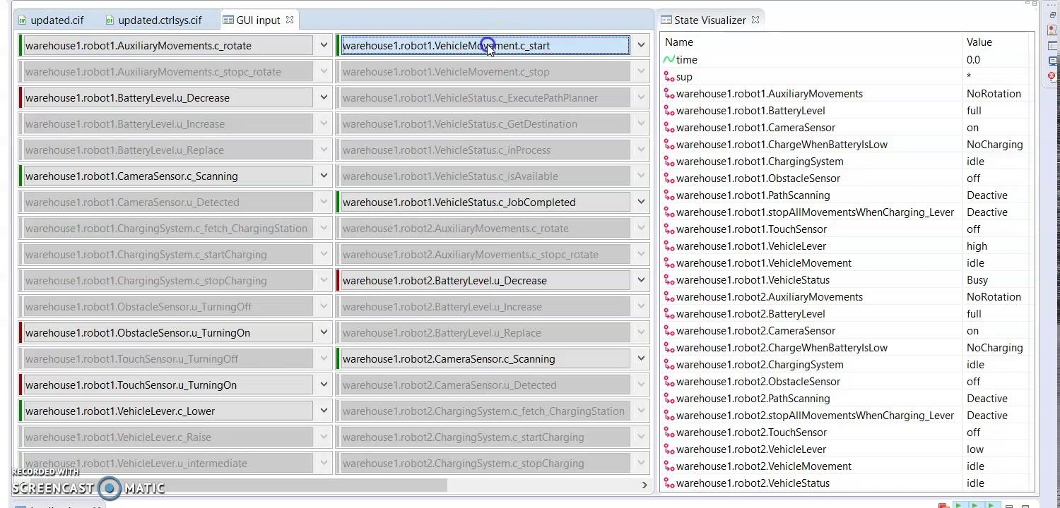
PLANT DEFINITIONS -
Demo (Effect of sensor values on vehicle’s movement )

Slide 13
PLANT DEFINITIONS
Battery Level
Increase
Uncontrollable events - Increase, Decrease and Replace
States - Full, Low and Critical
Initial and Marked state - Full
Decrease
Decrease
FULL
LOW
CRITICAL
Replace

Slide 14
PLANT DEFINITIONS
Charging System
Controllable events - Fetch charging station, Start charging, Stop charging
States - Full, Low and Critical
Initial and Marked state - Idle
Fetch Charging System
Start Charging
IDLE
FETCH
CHARGING
Stop Charging

Slide 15
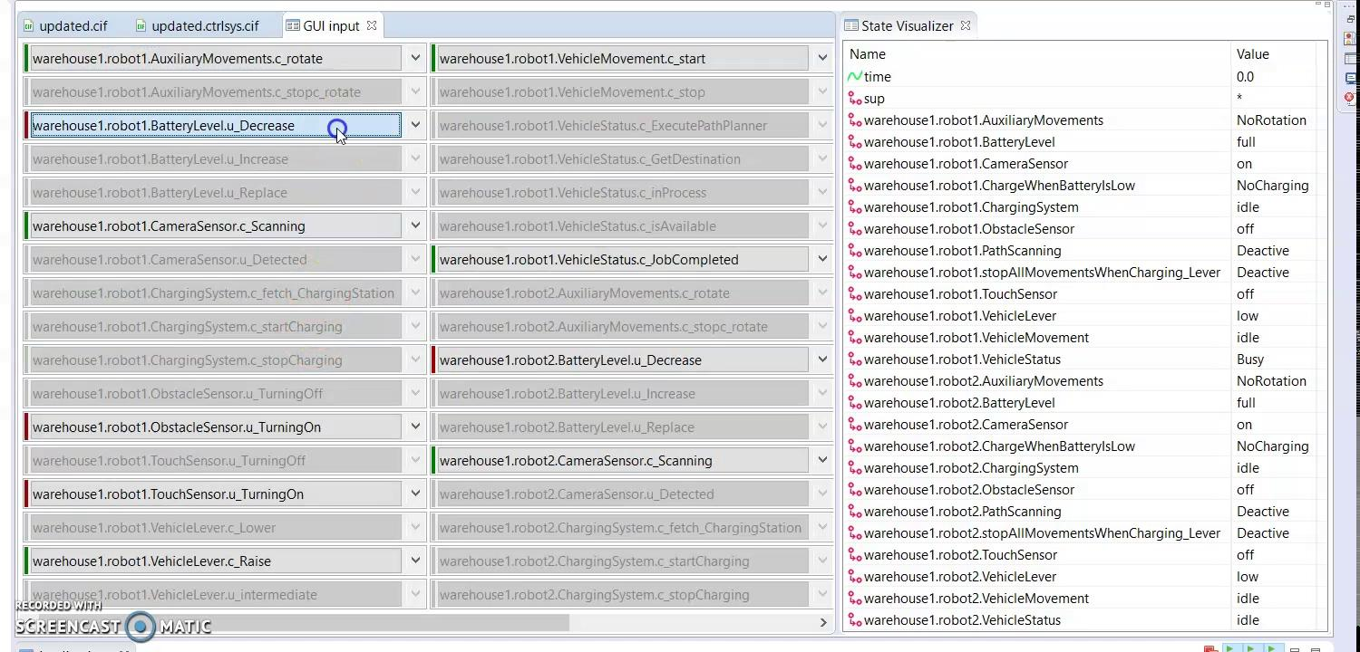
PLANT DEFINITIONS -
Demo (Battery charging and sensor values during vehicle movement)

Slide 16
SYSTEM OF MULTIPLE ROBOTS
ASSUMPTIONS MADE:
All the robots have a centralised path planning controller which ensures that there is no collision between robots within the same system.
The resource allocator is centralised and keeps a check of the robot after it leaves or enters the Pick or Drop location.
PLANT 1
PLANT 2
PLANT 3
CONCLUSIONS:
All the safety requirements listed in the problem statement have been implemented in the design of the centralised supervisory control.
The system can be implemented for both single and ‘m’ other vehicles in grid for stated assumptions.

Slide 17
THANK YOU!
Department, Sub department or Capacity Group
Department of Mathematics and Computer Science Engineering, Automotive Systems Design

